Slide 1

Team Details
Team name: PANDA GANG
Team leader name: ROHAN DAS
Problem Statement: Civic Grievance Tracking Dashboard for Hyderabad Citizens and Students

Slide 2
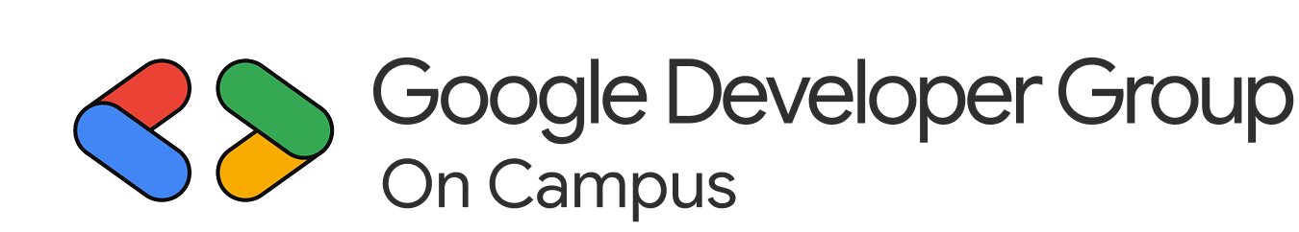
Problem Statement: Citizens and students in Hyderabad often face challenges in reporting and tracking civic issues such as potholes, waste management, water leakage, and streetlight failures. Existing grievance systems are fragmented, lack transparency, and provide limited feedback on issue resolution. This leads to frustration, inefficiency, and reduced civic participation among the public.
Proposed Solution: The Civic Grievance Tracking Dashboard is an AI-powered, data-driven platform designed to streamline the reporting, monitoring, and resolution of civic issues across Hyderabad. It empowers citizens and students to:
Report issues seamlessly through an intuitive web and mobile interface.
Track real-time progress of complaints using visual dashboards and status updates.
Enhance accountability by integrating with municipal departments and leveraging Google technologies for location tagging.
By centralizing communication between citizens and civic authorities, the dashboard fasters transparency, encourages community engagement, and contributes to a smarter, more responsive urban ecosystem.

Slide 3
Opportunities:
The Civic Grievance Tracking Dashboard introduces a unified, transparent, and data-driven approach to civic issue management, setting it apart from existing systems. Unlike traditional platforms that only record complaints, this solution integrates real-time tracking, AI-powered insights, and Google technologies to enhance efficiency and accountability. It consolidates multiple reporting channels into one centralized platform, enabling citizens and students to report issues with geotagged photos and track progress through interactive dashboards.
By leveraging Google Maps API, Firebase, and Google Cloud, the system ensures scalability, reliability, and seamless data synchronization. Its predictive analytics identify recurring issues and high-risk zones, allowing authorities to take preventive measures. The inclusion of gamified participation encourages civic engagement among students and citizens, fostering a sense of community responsibility. This solution effectively addresses the problem by streamlining complaint reporting, improving transparency, and ensuring faster resolution through automated routing and real-time updates. It empowers both citizens and civic authorities with actionable insights, promotes accountability, and transforms Hyderabad into a smarter, more responsive city.

Slide 4
List of features offered by the solution:
Unified Complaint Registration: Single web/mobile platform for citizens to report civic issues (potholes, garbage, water leakage, streetlights) with photo upload and AI-assisted descriptions.
Geo-Tagged Issue Reporting: Google Maps API integration enables precise GPS location tagging, ensuring accurate routing to concerned departments and real-time map visibility.
Real-Time Tracking Dashboard: Users monitor complaint status ("Submitted" → "In Progress" → "Resolved") on personal dashboard with live notifications at each resolution stage.
AI-Powered Categorization & Smart Navigator: ML algorithms auto-classify complaints by type/urgency/location. Smart Navigator routes citizens around unresolved hazards with fastest vs. safest options.
Data Analytics & Risk Visualization: Admin dashboards display trends, recurring issues, performance metrics, and AI-generated risk heatmaps for data-driven civic decision-making.

Slide 5
Google Technologies used in the solution
Google Maps Platform: Enables precise geo-tagging of complaints and interactive maps to visualize civic issues across Hyderabad. Powers Smart Navigator for routing citizens around unresolved hazards with fastest vs safest options. API keys generated and managed securely through Google Cloud Console.
Firebase: Handles real-time Firestore database for storing complaints and user data with instant synchronization. Provides authentication for secure login/signup and Firebase Cloud Messaging for push notifications. API credentials configured and monitored via Google Cloud Console.
Gemini AI (via Google Genkit): Refines complaint descriptions automatically and categorizes issues by type, urgency, and location. Generates Impact Simulator predictions and risk-weighted heatmaps for admin dashboards. API keys securely managed in Google Cloud Console with usage tracking.
Google Cloud Console: Central management platform for generating, monitoring, and securing all API keys (Maps, Routes, Firebase, Gemini). Enables billing controls, usage analytics, and access management for production deployment.

Slide 6
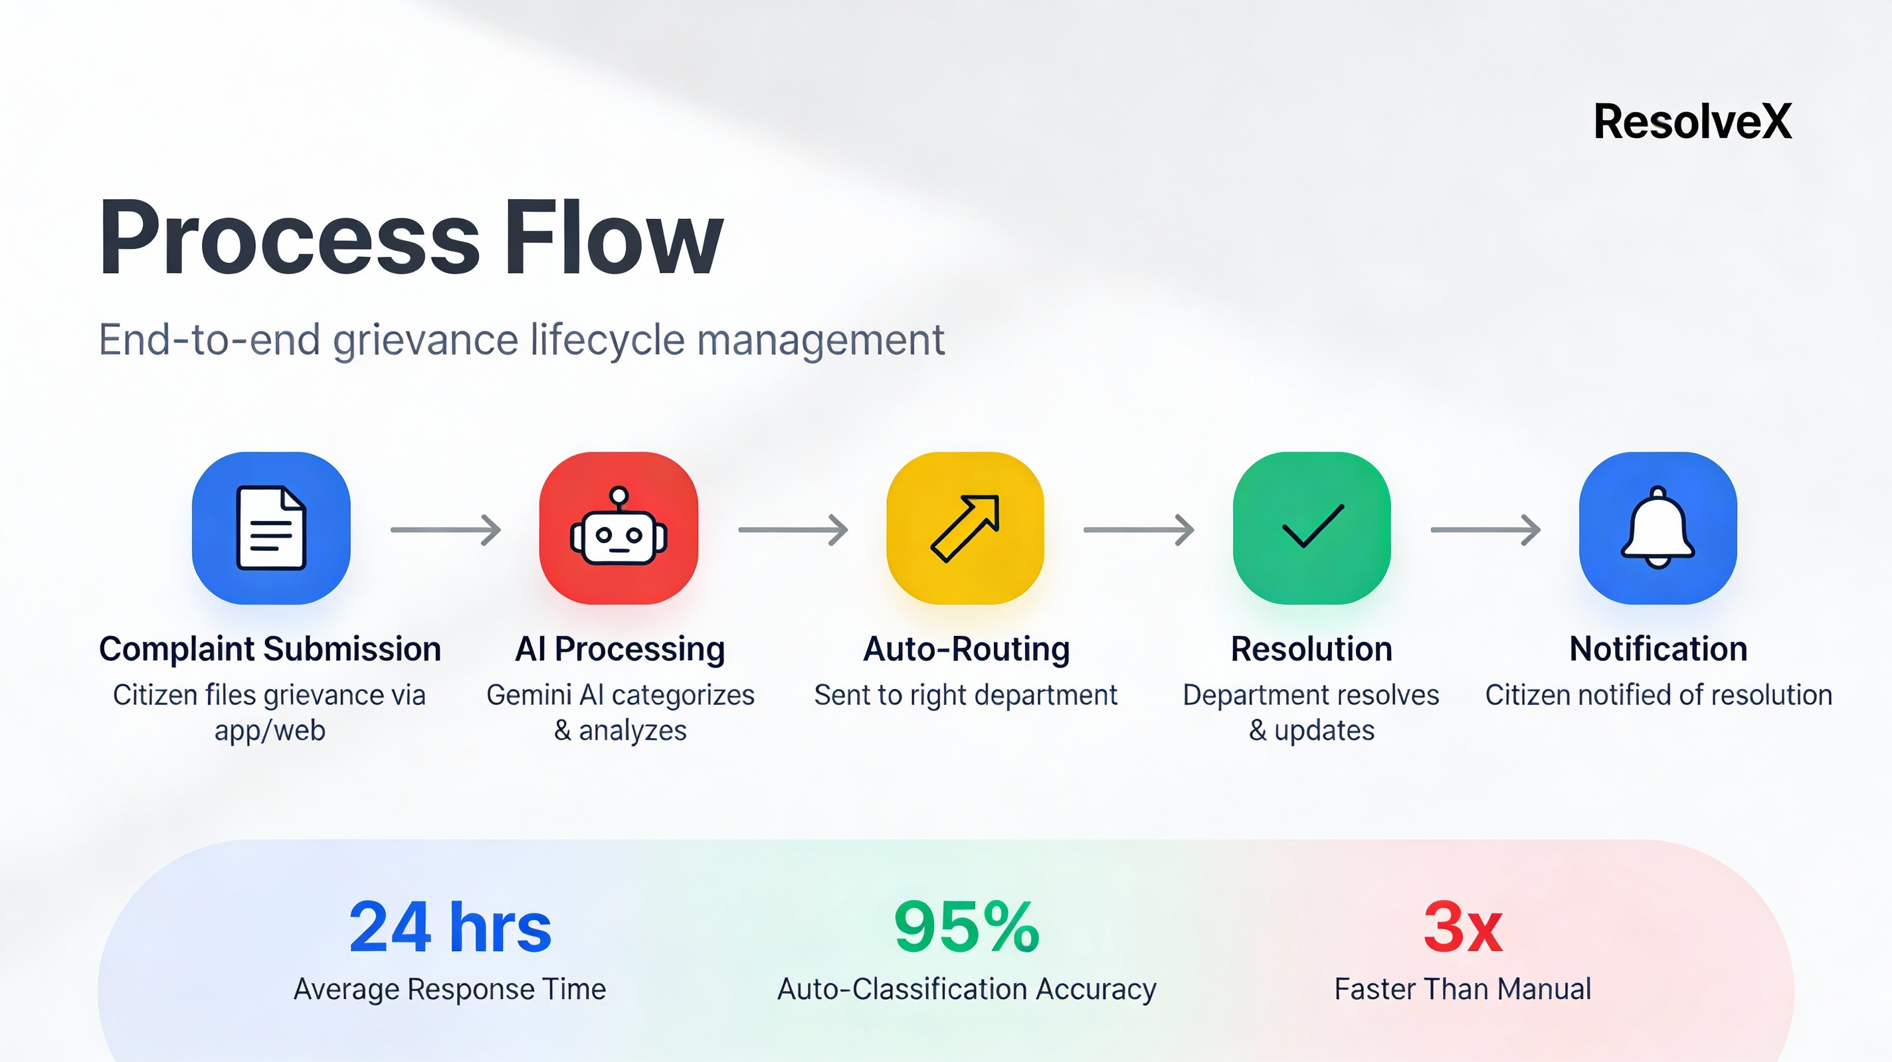
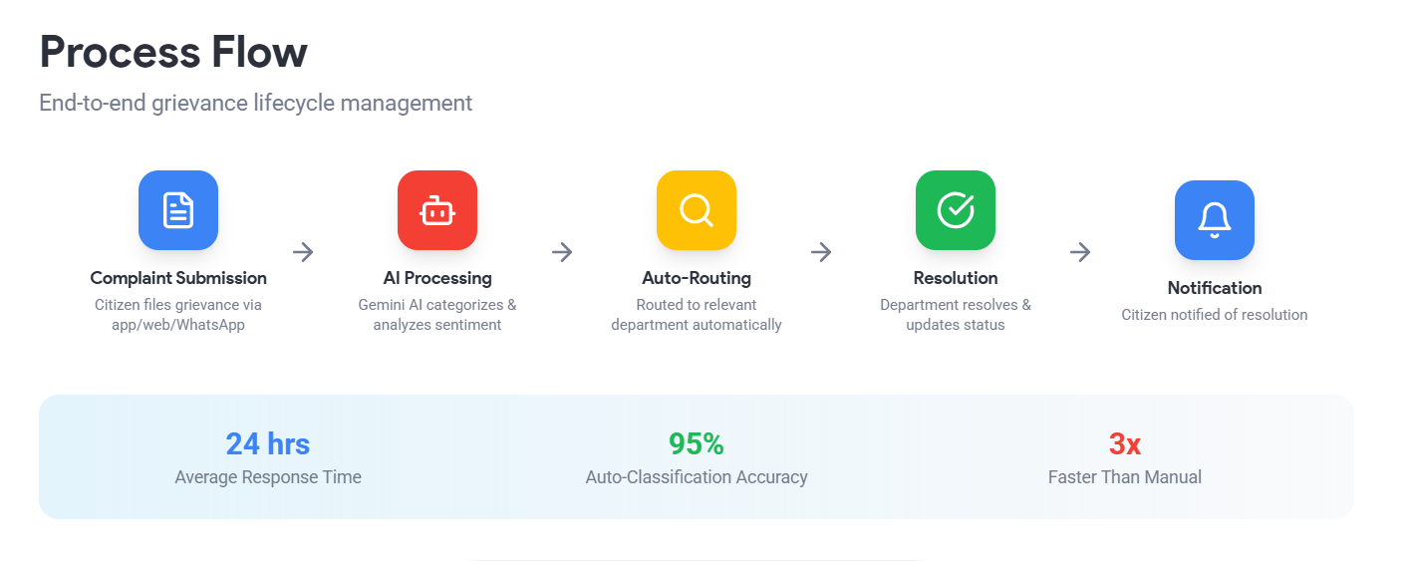

Slide 7
Wireframes
1. Citizen/Student Interface:
Home Screen: Options to Report Issue, Track Complaint, View Insights with a city map showing complaint hotspots.
Report Issue: Fields for title, category, description, photo upload,and auto-location tagging via Google Maps.
Track Complaint: Displays complaint ID, status (Pending/In Progress/Resolved), and progress bar for real-time tracking.
2. Department Dashboard:
View assigned complaints with filters by category and status.
Update or close complaints and upload resolution proof.
Analytics panel showing complaint trends and resolution times.
3. Admin Dashboard:
Overview of total complaints, user activity, and department performance.
Interactive charts for city-wide trends and resource management.
4. Feedback Screen:
Citizens rate service (1–5 stars) and add comments after resolution.The layout emphasizes ease of use, transparency, and real-time interaction between citizens, departments, and administrators.

Slide 8
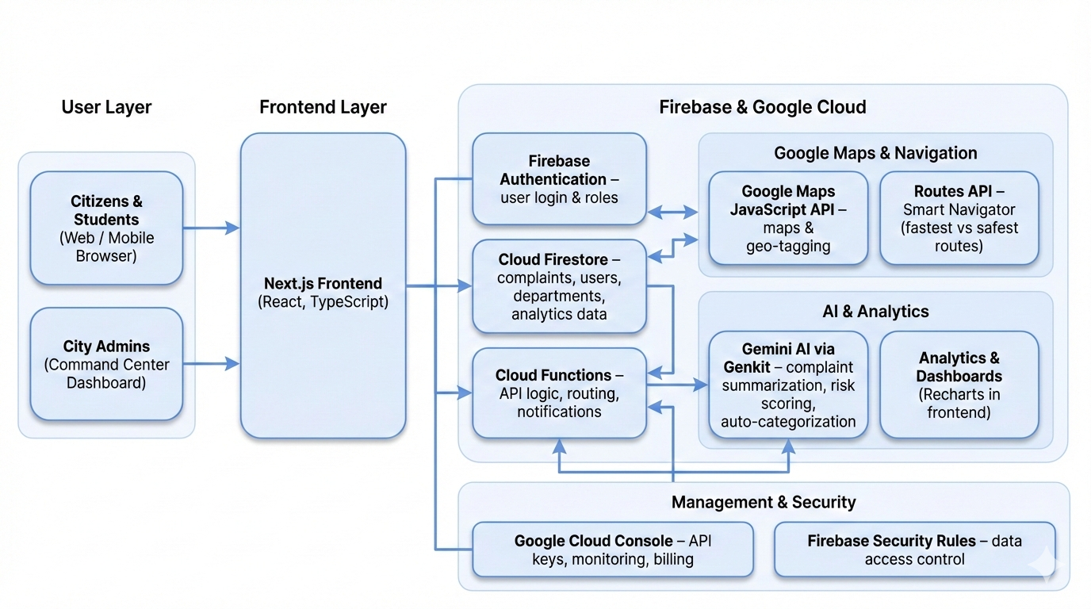
Architecture diagram of the proposed solution

Slide 9
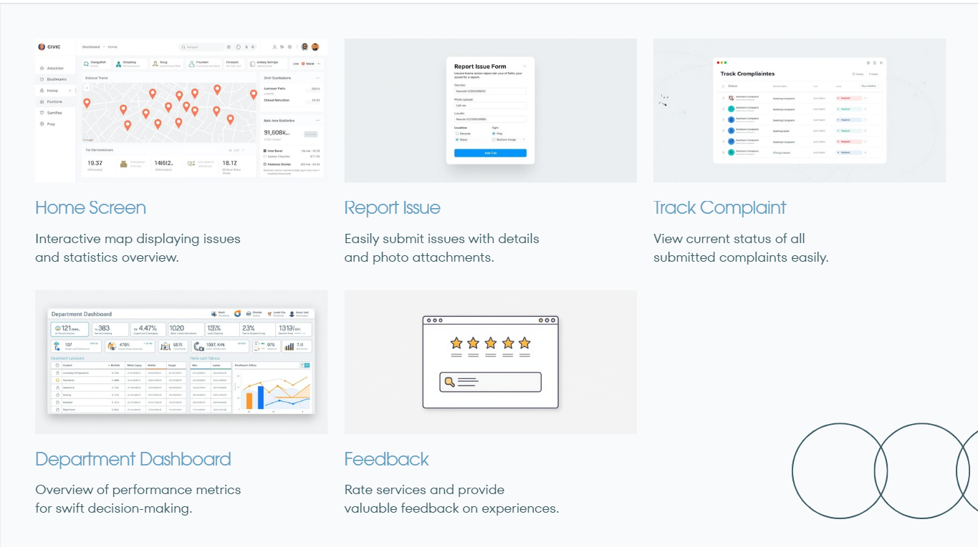
Snapshots of the MVP

Slide 10
Future Development
Technology Stack: The MVP is built using Firebase for authentication and real-time database management, Google Cloud for storage and analytics, and Google Maps API for location tagging and visualization.
User Roles: Three main user roles are defined Citizen/Student, Department Officer, and Administrator each with specific access levels and dashboards.
Data Flow: Complaints submitted by users are stored in the database, automatically categorized, and routed to the relevant department. Updates from departments are reflected in real time on the user’s dashboard.
Security Measures: Role-based access control, encrypted data transmission, and secure cloud storage ensure data privacy and integrity.
Scalability: The architecture supports easy scaling to other cities or regions by modifying configuration parameters without major structural changes.
Performance Monitoring: Built-in analytics track complaint resolution times, and user engagement to continuously improve service delivery.

Slide 11
Provide links to your:
GitHub Public Repository: https://github.com/Amrutha80079/Civic-Grievance-Tracking-Dashboard-for-Hyderabad-Citizens-and-Students.git
Demo Video Link (3 Minutes)
MVP Link: https://studio--studio-687393081-9652d.us-central1.hosted.app/

Slide 12
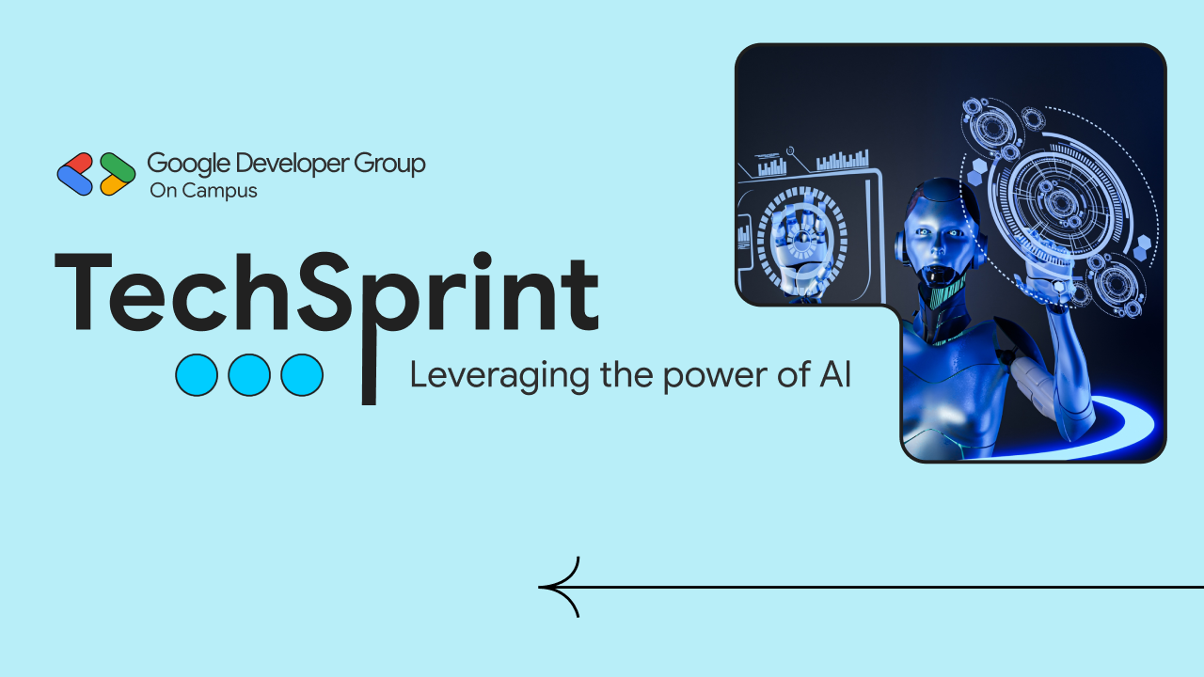
Thank you!

